Slide 1
HOW TO ADD FOREIGN KEY CONSTRAINS ON TABLES
Step by Step Guide
Author: Noshaba Nasir

Slide 2
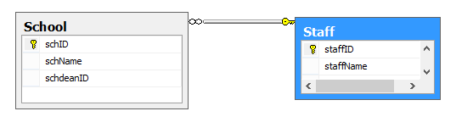
These slide will show how to create Foreign Key relationship between tables , using design view and scripts as well
Example used in these slides is as shown in figure.
Here Staff is table to be referred by table School , and the reference column is StaffID

Slide 3
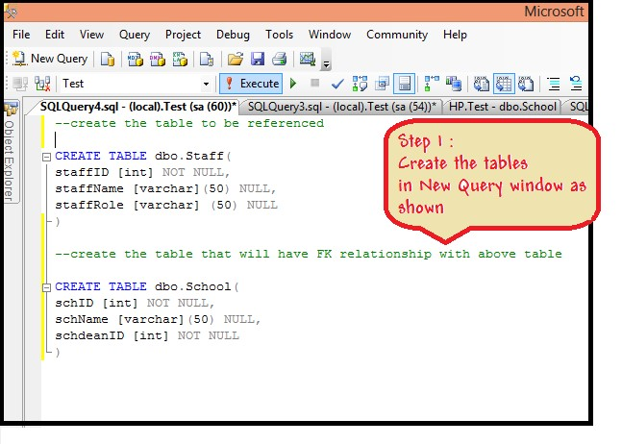
1st with Designer View
Follow the steps to create FK using design view

Slide 4
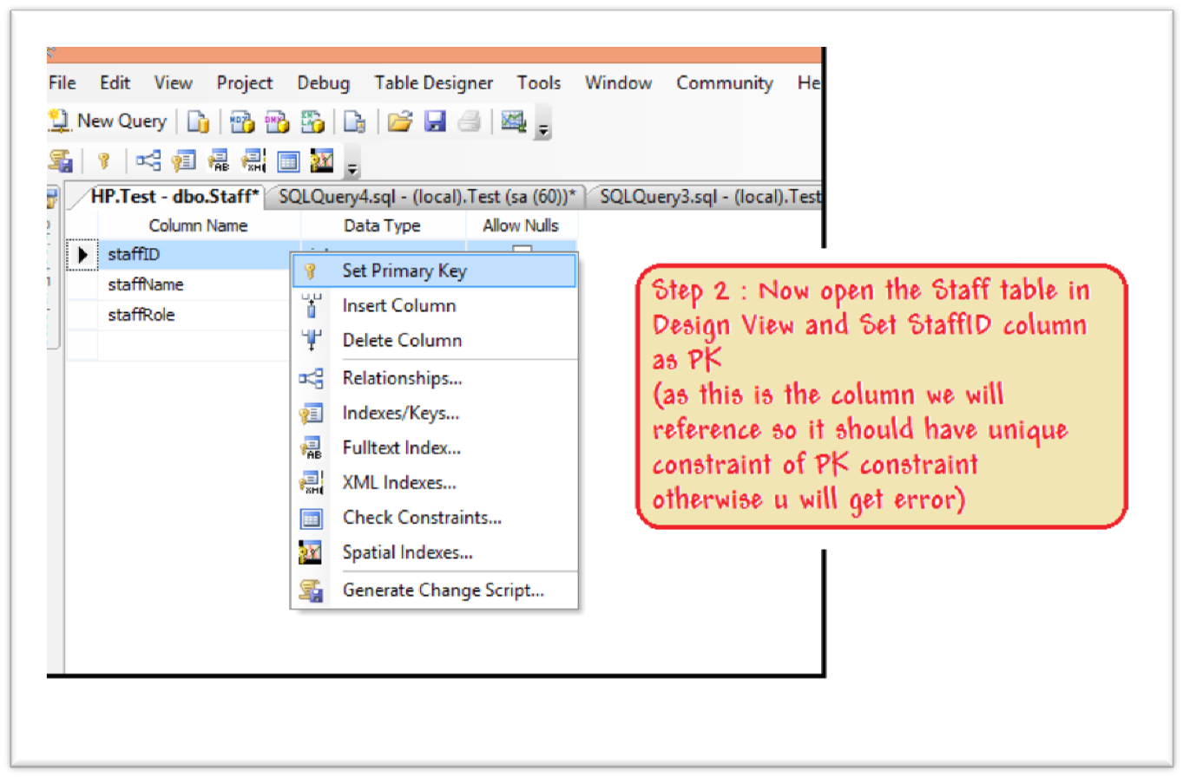

Slide 5
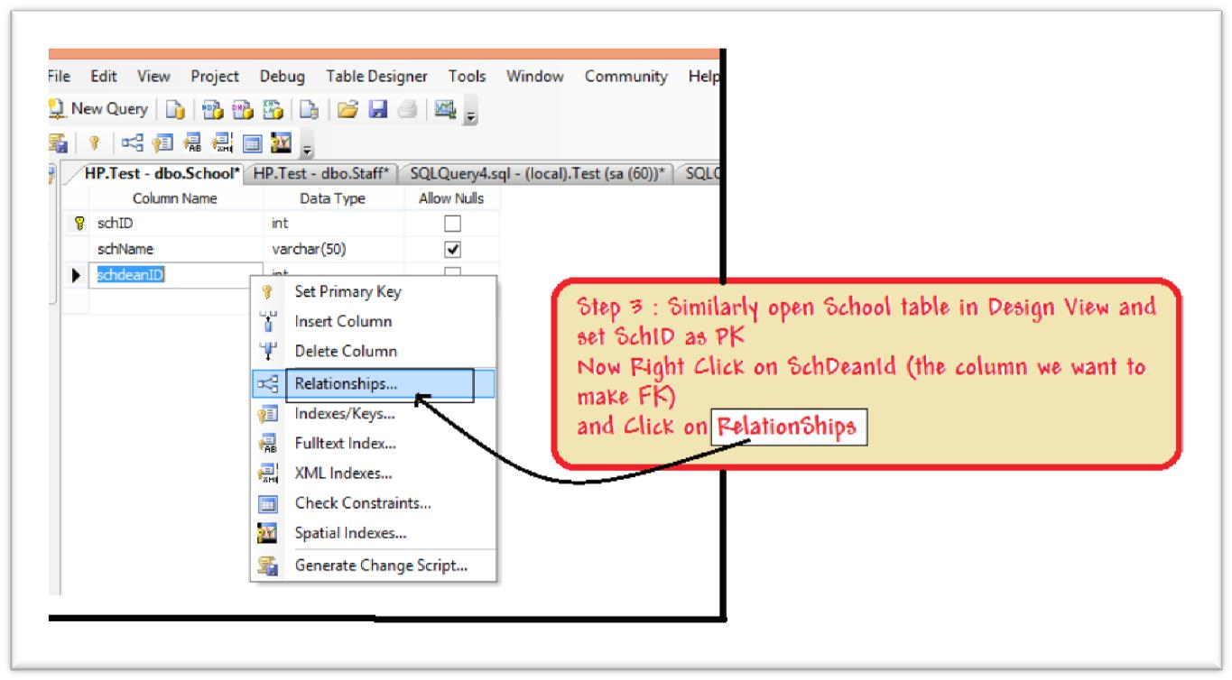

Slide 6
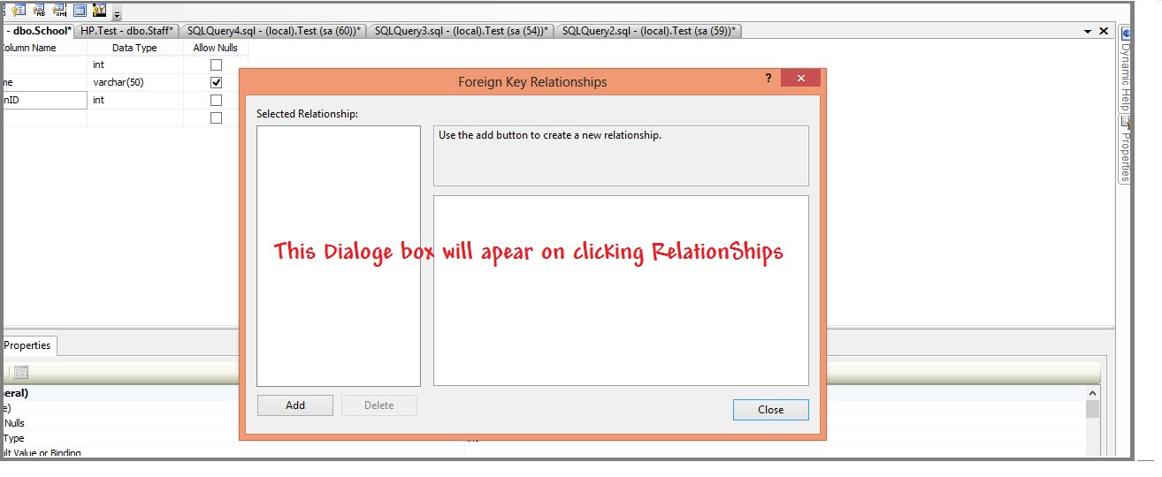

Slide 7
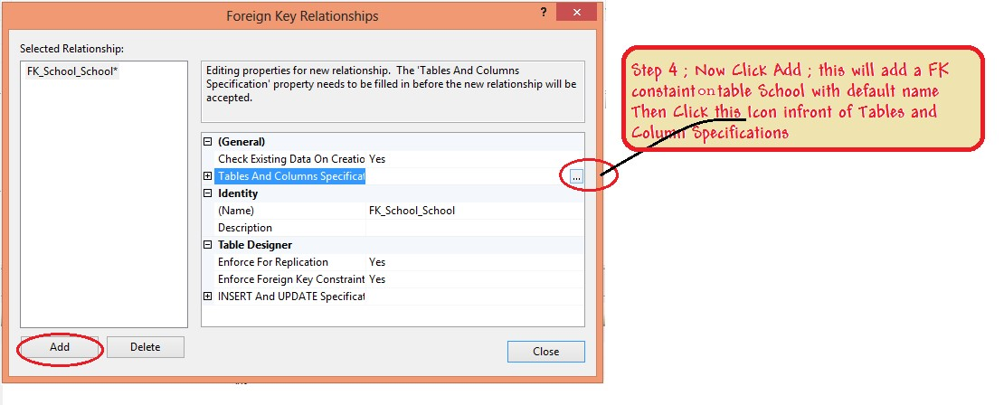

Slide 8
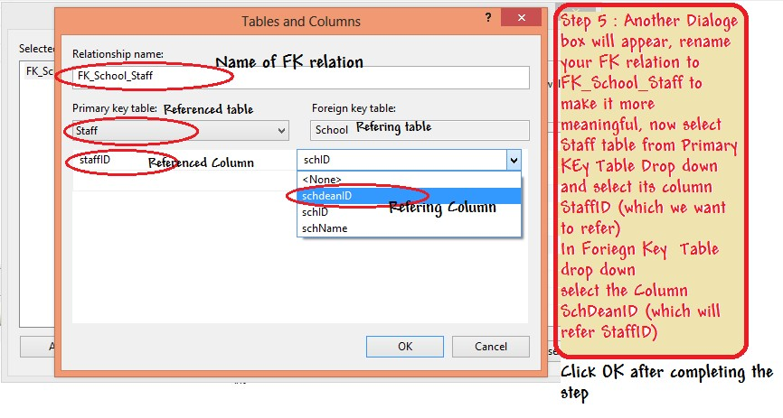

Slide 9
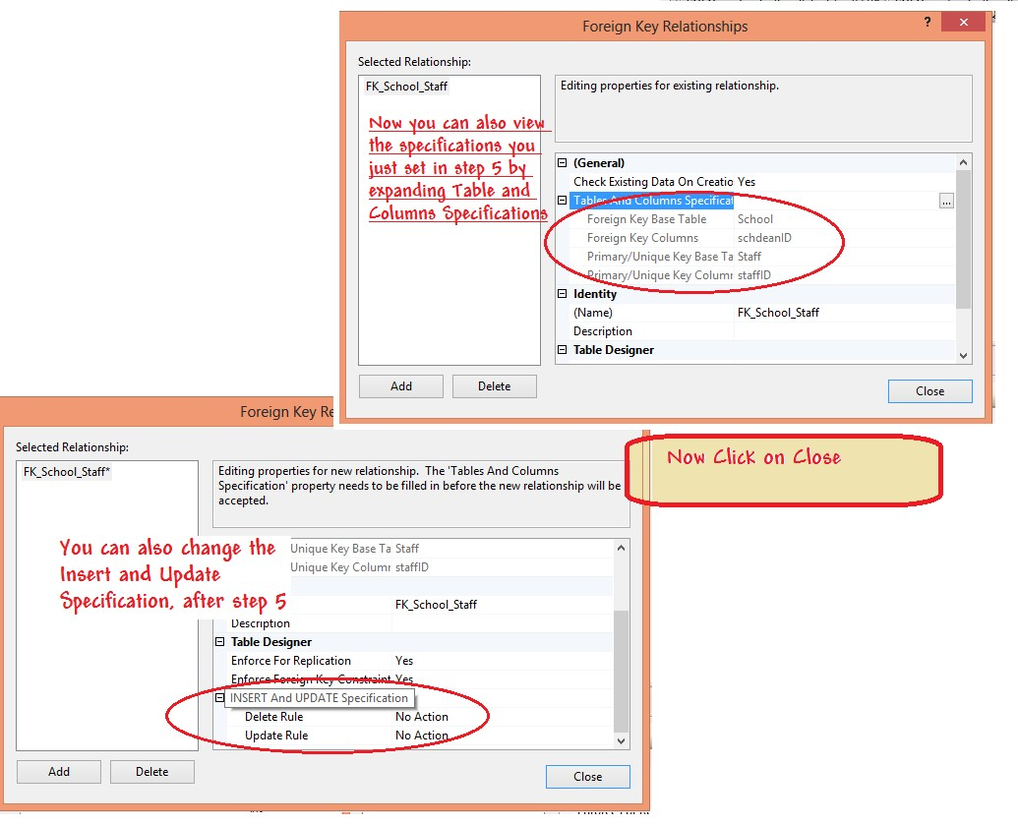

Slide 10
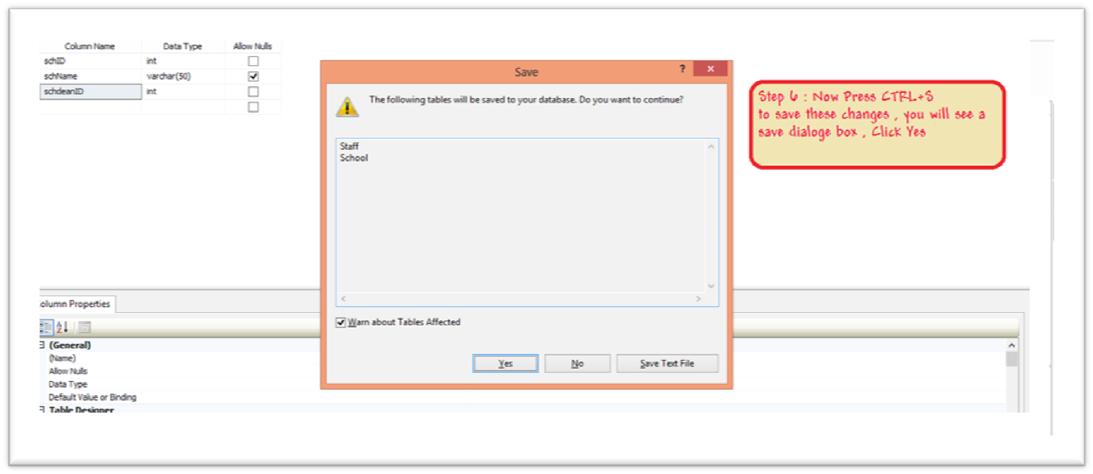

Slide 11
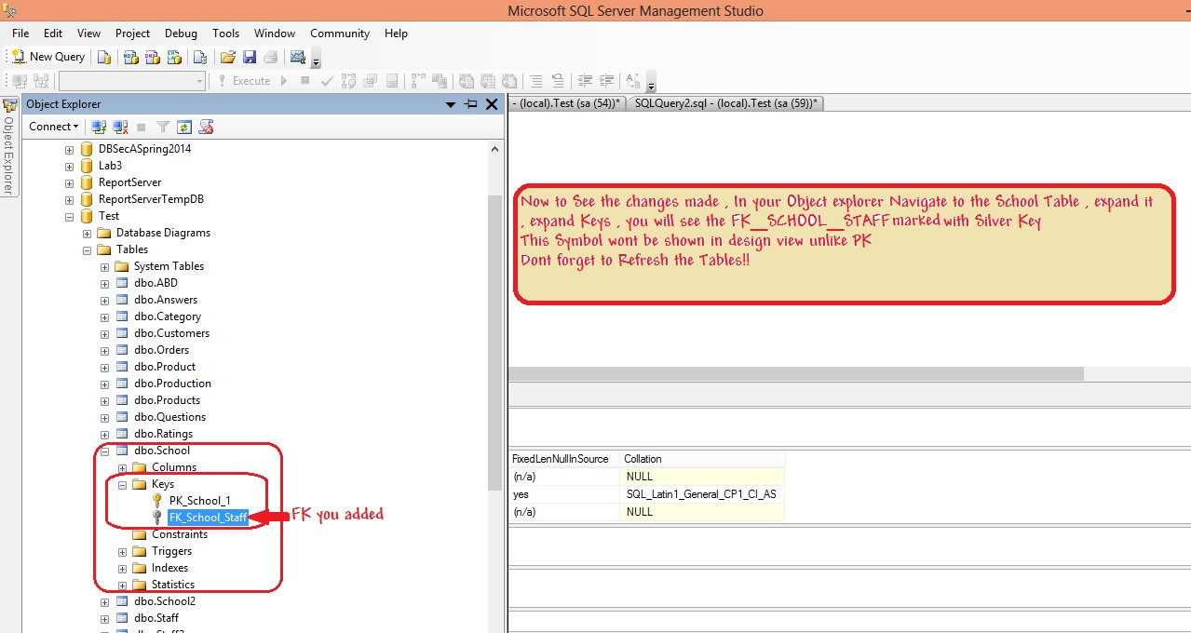

Slide 12
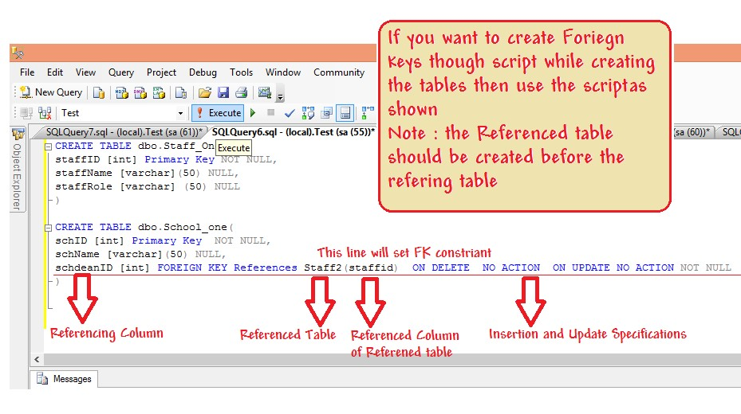
2nd Creating FK relation using Query:
You can also create FK with Scripts as given below

Slide 13
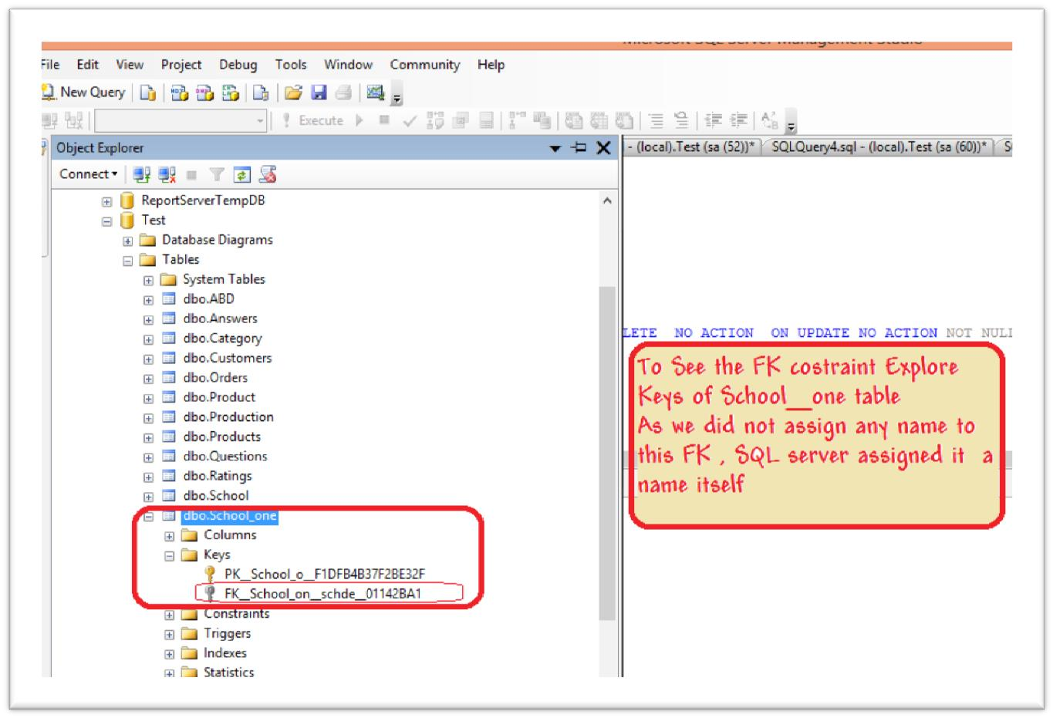

Slide 14
